Slide 1

DESIGN PROJECT 3:WEEKLY PROGRESS 3
TICKET VERIFIER
PASSY MUKUNA LUFULUABO
Student Number :215270835
Lecturer/Supervisor: V Moyo
Date: 3/18/2019

Slide 2
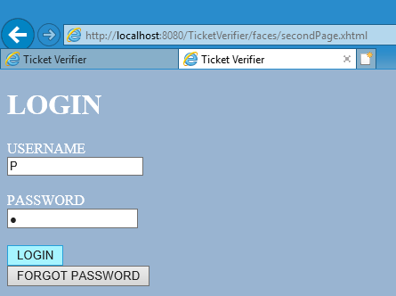
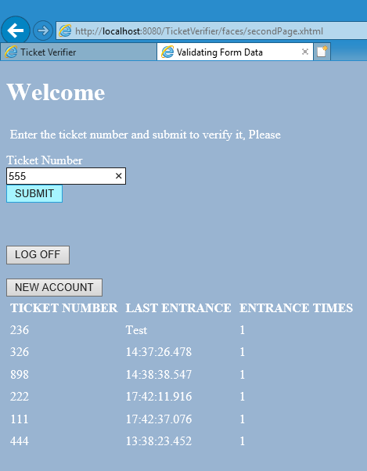
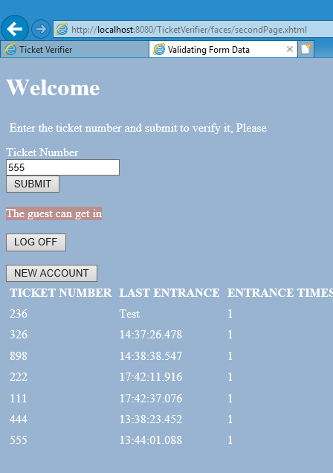
So far ticket verifier can do only one of its main functions. It can only capture the ticket number and let the guest enter for the first time
Week before Last week I implemented the design, GUI codes. And last week I have been struggling to do the first deliverable. So this It does the following as you can see in the screenshots

Slide 3
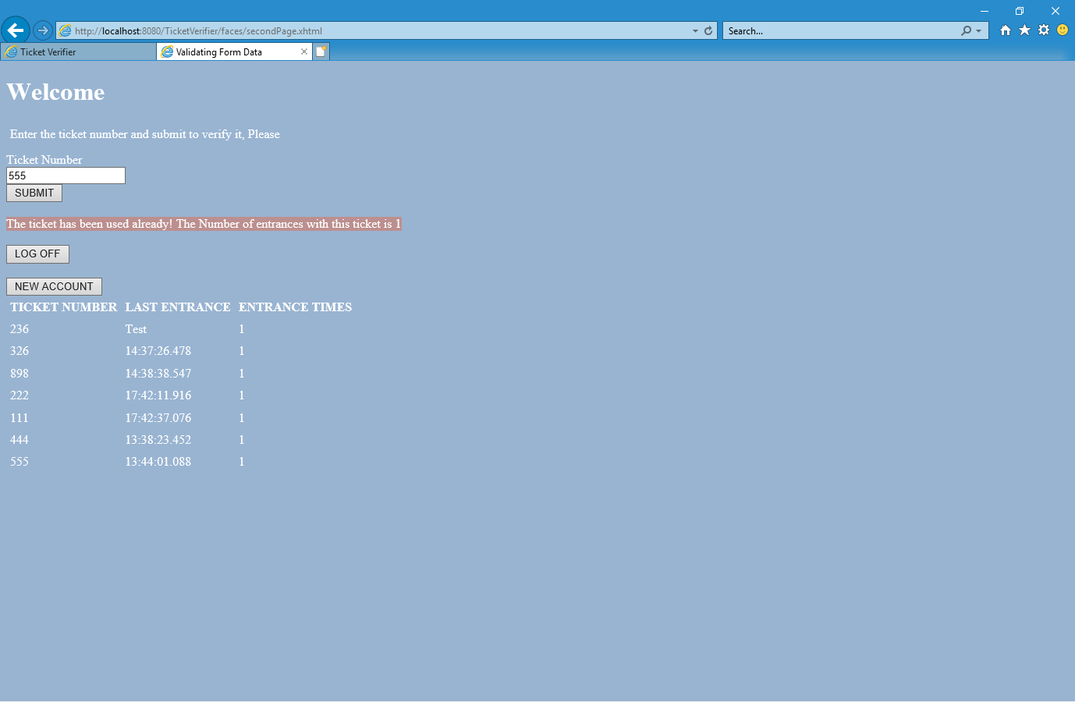
But There is a problem. The software is supposed to give me an option either to let the guest enter or not by giving how many times the guest has been inside. As you can see It does not do so. I thought of implementing a pop up window for that. That is my next task and other deliverables.

